Slide 1
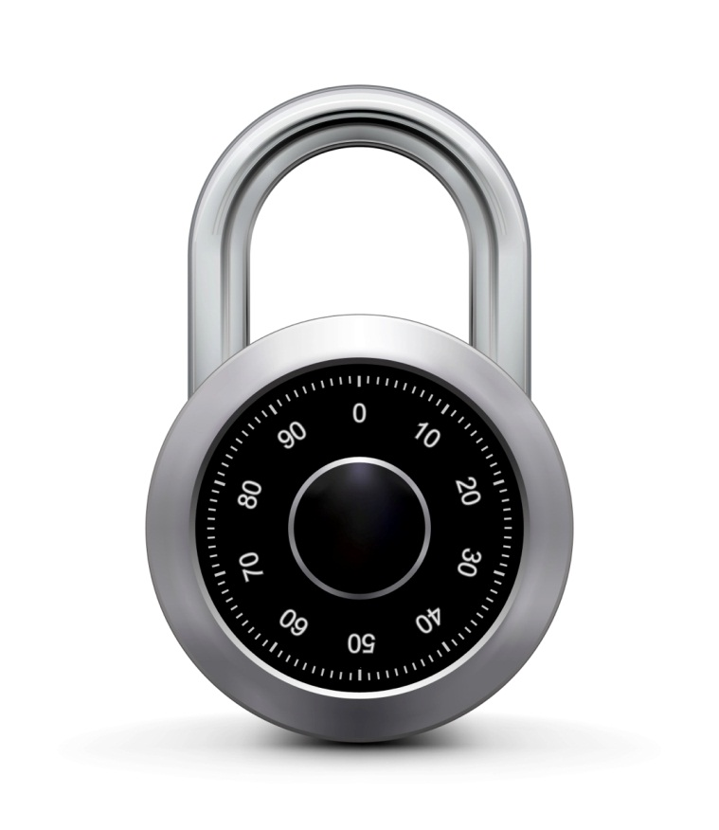
Real-world Stream Ciphers
Online Cryptography Course Dan Boneh
Stream ciphers

Slide 2

Old example (software): RC4 (1987)
2048 bits
128 bits
1 byte
per round
seed
Used in HTTPS and WEP
Weaknesses:
Bias in initial output: Pr[ 2nd byte = 0 ] = 2/256
Prob. of (0,0) is 1/256² + 1/256³
Related key attacks

Slide 3
Old example (hardware): CSS (badly broken)
Linear feedback shift register (LFSR):
DVD encryption (CSS): 2 LFSRs
GSM encryption (A5/1,2): 3 LFSRs
Bluetooth (E0): 4 LFSRs
all broken

Slide 4
Old example (hardware): CSS (badly broken)
CSS: seed = 5 bytes = 40 bits

Slide 5
Cryptanalysis of CSS (2¹⁷ time attack)
17-bit LFSR
8
encrypted movie
⊕
+ (mod 256)
8
prefix
25-bit LFSR
8
CSS prefix
For all possible initial settings of 17-bit LFSR do:
Run 17-bit LFSR to get 20 bytes of output
Subtract from CSS prefix ⇒ candidate 20 bytes output of 25-bit LFSR
If consistent with 25-bit LFSR, found correct initial settings of both !!
Using key, generate entire CSS output

Slide 6
Modern stream ciphers: eStream
PRG: {0,1}^{s} × R ⟶ {0,1}^{n}
Nonce: a non-repeating value for a given key.
E(k, m ; r) = m ⊕ PRG(k ; r)
The pair (k,r) is never used more than once.

Slide 7
eStream: Salsa 20 (SW+HW)
Salsa20: {0,1} ¹²⁸ ^{or 256} × {0,1}⁶⁴ ⟶ {0,1}^{n} (max n = 2⁷³ bits)
Salsa20( k ; r) := H( k , (r, 0)) ll H( k , (r, 1)) ll …
h: invertible function. designed to be fast on x86 (SSE2)
τ₀ k τ₁ r i τ₂ k τ₃
kr
i
⊕
64 byte
output
h
(10 rounds)
32 bytes
64 bytes
64 bytes
Notes:
Xor is actually word-wise addition. τ_{i} fixed constant.

Slide 8
Is Salsa20 secure (unpredictable) ?
Unknown: no known provably secure PRGs
In reality: no known attacks better than exhaustive search

Slide 9
Performance: Crypto++ 5.6.0 [ Wei Dai ]
AMD Opteron, 2.2 GHz ( Linux)
PRG Speed (MB/sec)
RC4 126
Salsa20/12 643
Sosemanuk 727
eStream

Slide 10
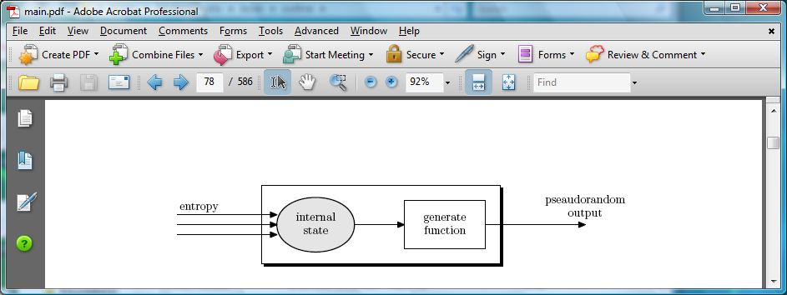
Generating Randomness (e.g. keys, IV)
Pseudo random generators in practice: (e.g. /dev/random)
Continuously add entropy to internal state
Entropy sources:
Hardware RNG: Intel RdRand inst. (Ivy Bridge). 3Gb/sec.
Timing: hardware interrupts (keyboard, mouse)
NIST SP 800-90: NIST approved generators

Slide 11
End of Segment

